Slide 1
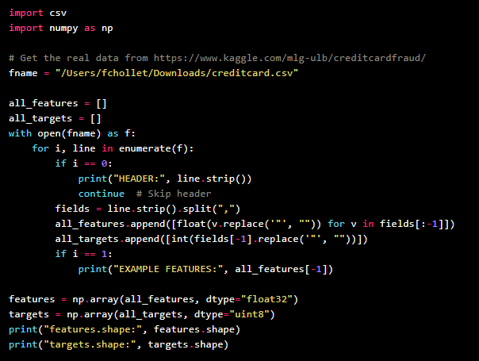
CREDIT CARD FRAUD DETECTION
In this lecture Kaggle Credit Car Fraud Detection dataset is used to demonstrate that how to train a classification model for imbalanced classes.

Slide 2
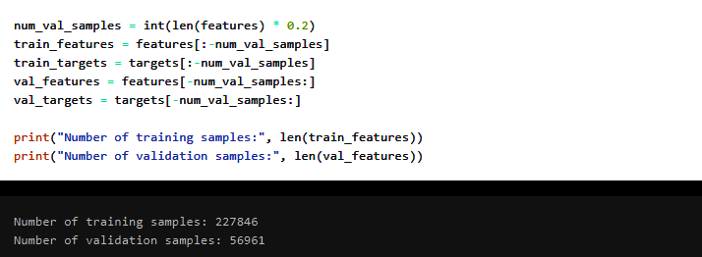
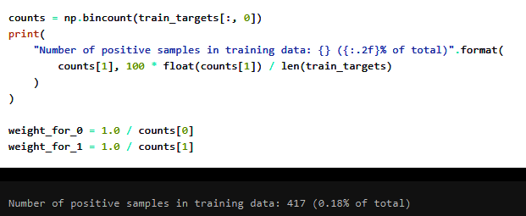
VALIDATION SET AND CLASS IMBALANCE

Slide 3
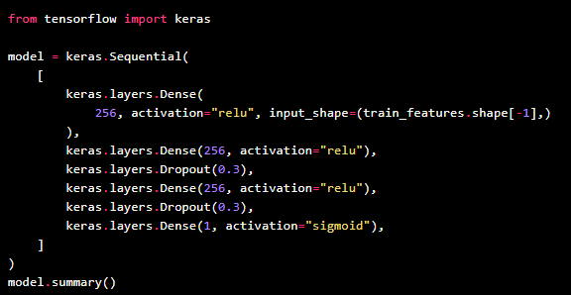
CLASSIFICATION MODEL

Slide 4
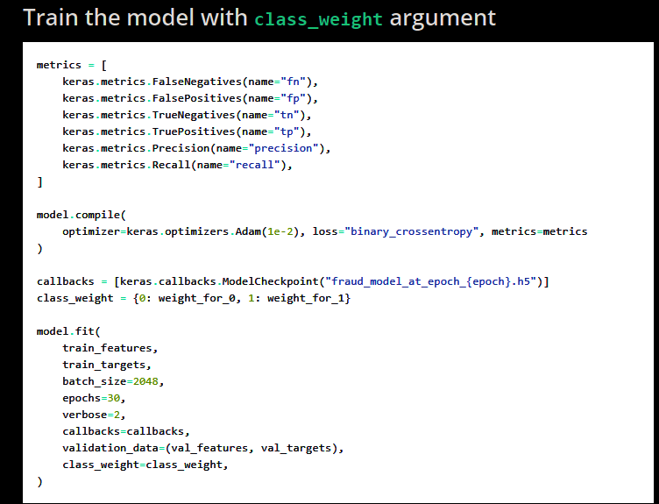
DATA AUGMENTATION

Slide 5
RESEULTS
At the end of training, out of 56,961 validation transactions:
Correctly identifying 66 of them as fraudulent.
Missing 9 fraudulent transactions.
At the cost of incorrectly flagging 441 legitimate transactions.
In the real world, one would put an even higher weight on class 1, so as to reflect that False Negatives are more costly than False Positives.
Next time your credit card gets declined in an online purchase -- this is why.

